Slide 1
Music of the Spheres
Mass and Distance in Curved Spacetime

Slide 2
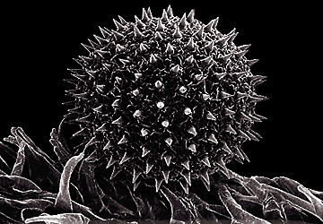
Spherical Symmetry
Copernicus and the heliocentric universe
All mass has a gravitational field
Uniform force on a malleable body
Symmetry in planets
Schwarzchild and spacetime near spheres

Slide 3
Seeing Space
You can’t see space
  Rectangular lattice to see flat spacetime
  Spherical lattice to see curved spacetime
What to build the lattice of?
What about a solid shell? A rocket?
How to measure the radius?
  circumference = 2Πr
  r-coordinate = circumference / 2Π

Slide 4
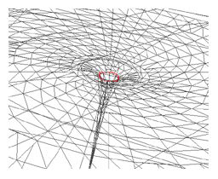
Comparing Shells
Distances between shells
Spacetime isn’t flat
Spatial distances are elongated
Time measurements are slowed

Slide 5
Gravitational Red Shift
wave velocity = wavelength / period
Constant velocity: period ↑, wavelength ↑
Roy G. Biv: longest to shortest wavelength
Horizon of a black hole
Hawking radiation
Gravitational blue shift

Slide 6
Mass in Meters
F = G * M_{kg} * m_{kg} / r²
G = 6.6726 x 10⁻¹¹ m³ / (kg s²)
G / c² = 7.424 x 10⁻²⁸ m / kg
Object | Mass | Geometric Mass
Earth | 5.97 x 10²⁴ kg | 4.44 x 10⁻³ m
Sun | 1.99 x 10³⁰ kg | 1.48 x 10³ m
Milky Way black hole | 5.2 x 10³⁶ kg | 3.8 x 10⁹ m
Virgo black hole | 6 x 10³⁹ kg | 4 x 10¹² m

Slide 7
Satelite Motion and Schwarzschild Geometry

